Slide 1

FACIAL RECOGNITION ATTENDANCE SYSTEM
Group Members
Yash Umredkar(20104012)
Shruti Pinjarkar(20104016)
Aryan Sankholkar(20104010)
Project Guide
Prof. Apurva Chaudhari

Slide 2
Contents
Introduction
Objectives
Scope
Literature Survey
Proposed System
Project Outcomes
Data Flow Diagram
Use Case
Technology Stack
Suggestions in Review-1
Result and Discussion
Conclusion and Future Scope
References

Slide 3
1. Introduction
Proposed system is based on face recognition to maintain the attendance record of students.
It can be used in Institutions for better privacy in attendance thus reducing proxy.
Problem identified- Earlier the attendance was taken on manual basis which causes a lot human work
Solution provided- A face recognition attendance system automatically identifies and confirms a person and records attendance based on their face detection thus manual work reduces

Slide 4
2. Objectives
To simplify and automate the process of recording and tracking students attendance through face recognition technology.
To reduce manual process errors by providing automated and a reliable attendance system which uses face recognition algorithm.
To increase privacy and security which student cannot while presenting themselves or their friend while they are absent.
To be cost effective as there is no use of hardware.

Slide 5
3. Scope
Provides facility for the automated attendance of students.
Uses live face recognition to recognize each individual and mark their attendance automatically.
Utilizes image processing to provide inputs to the system.
A face recognition attendance system automatically identifies and confirms a person and records attendance based on their face detection.

Slide 6
4.Literature Survey
Sr.no | Title | Author(s) | Year | Outcomes | Methodology | Result
 | Facial Recognition: A Literature Review | A. S. Tolba, A.H. El-Baz, and A.A. El-Harby | 2005 | A parameter-based combined classifier has been developed in order to improve the generalization capability and hence the system performance of face recognition system | Facial recognition attendance systems typically use a combination of hardware and software to capture images of people's faces, analyze those images, and match them against a database of known individuals to determine their identity. | Facial recognition systems have a high accuracy rate in identifying individuals, as they use unique biometric information that is difficult to replicate

Slide 7
4.Literature Survey
Sr.no | Title | Author(s) | Year | Outcomes | Methodology | Result
 | Face Recognition and Identification using Deep Learning Approach | KH Teoh, RC Ismail and SZM Naziri. | 2020 | The accuracy of face recognition on image is higher than the accuracy on the real-time video. It can be observed that the resolution of image is a lot better than the real-time video. | The deep learning-based facial recognition attendance system involves data collection, model training, feature extraction and classification. It uses a large dataset to train a deep learning model to recognize unique facial features, which is used for attendance tracking. | In this paper, a face recognition and identification system is designed and developed using deep learning approach.

Slide 8
5. Proposed System
This proposed system is developed for deploying an easy and a secure way of taking down attendance.
It first captures an image of all the authorized persons and stores the information into database.
Then it stores the image by mapping it into a face coordinate structure.
Lastly it compares the image of the test and the training image and determines who is and is not present.
Proposed system will also be able to export and import attendance data as required in CSV format.

Slide 9
7. Project Outcomes
Efficient attendance tracking which can simplify and automate the process of taking attendance
By storing images of authorized persons, the system can ensure that only those individuals who are authorized can be marked as present.
Export/import attendance data for daily, monthly attendance records.

Slide 10
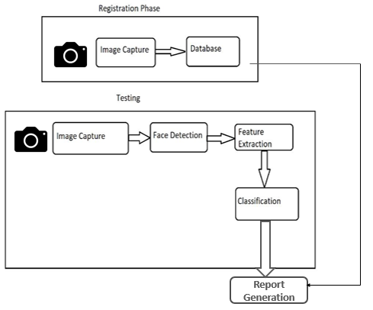

8. Data Flow Diagram

Slide 11
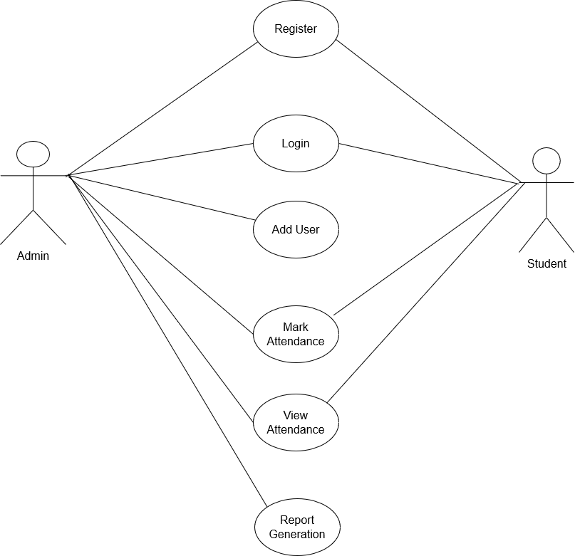
9. Use Case

Slide 12


10. Technology Stack
Frontend
Tkinter
Python
Backend
SQlite

Slide 13
11. Suggestions in Review-1
Be able to import student details in the form of csv files to save time.

Slide 14
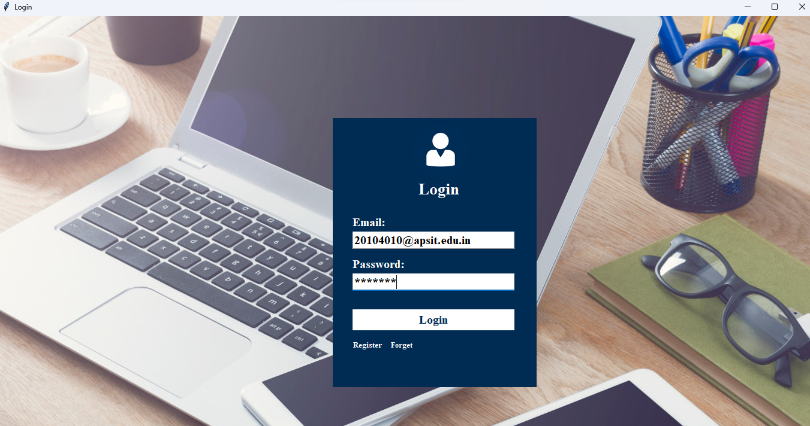
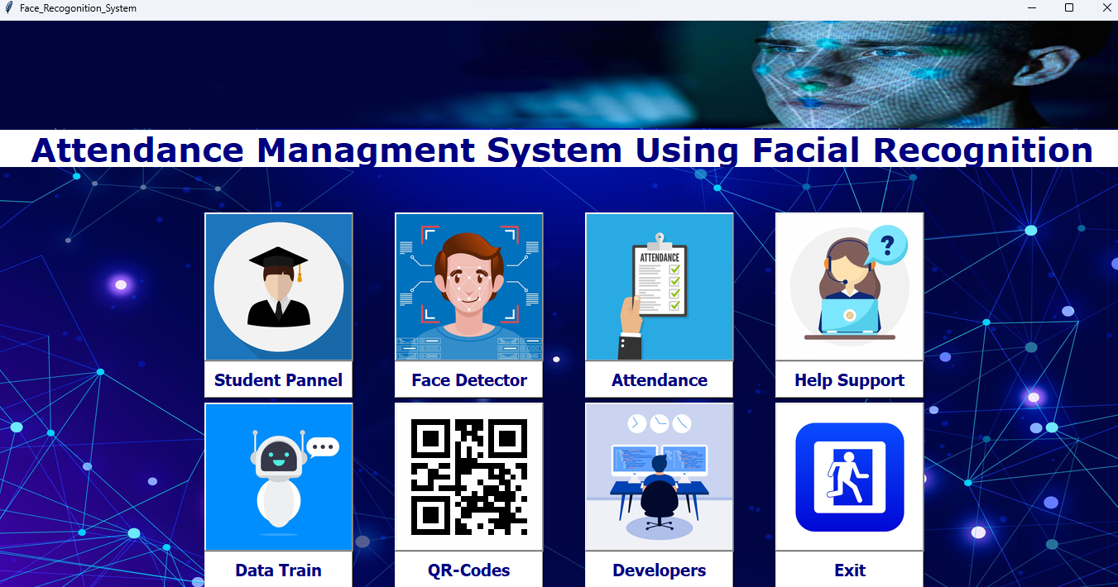
12. Result and Discussion
Main Page
Login Page

Slide 15
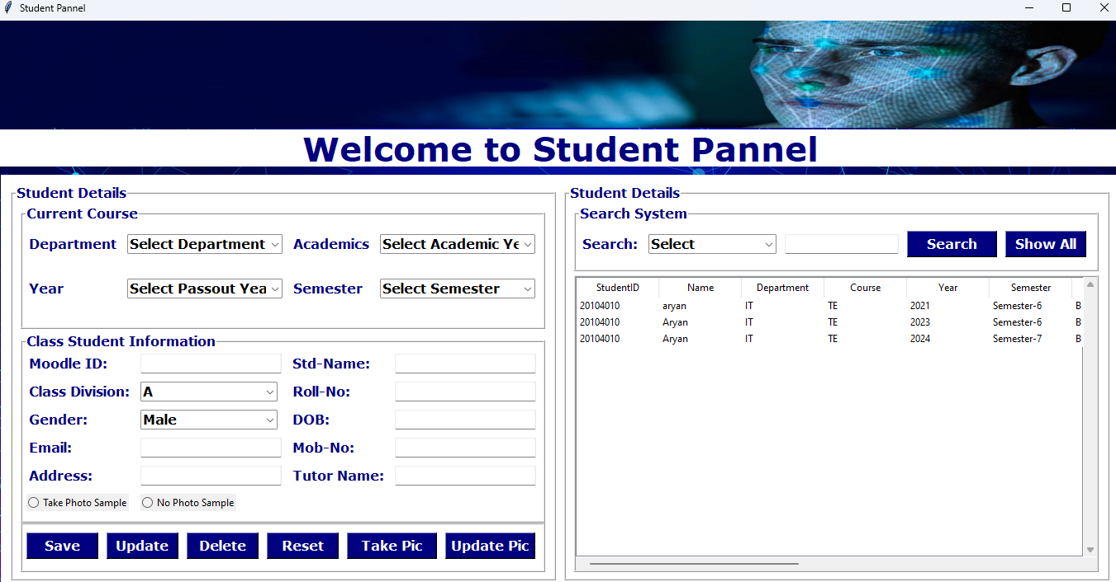
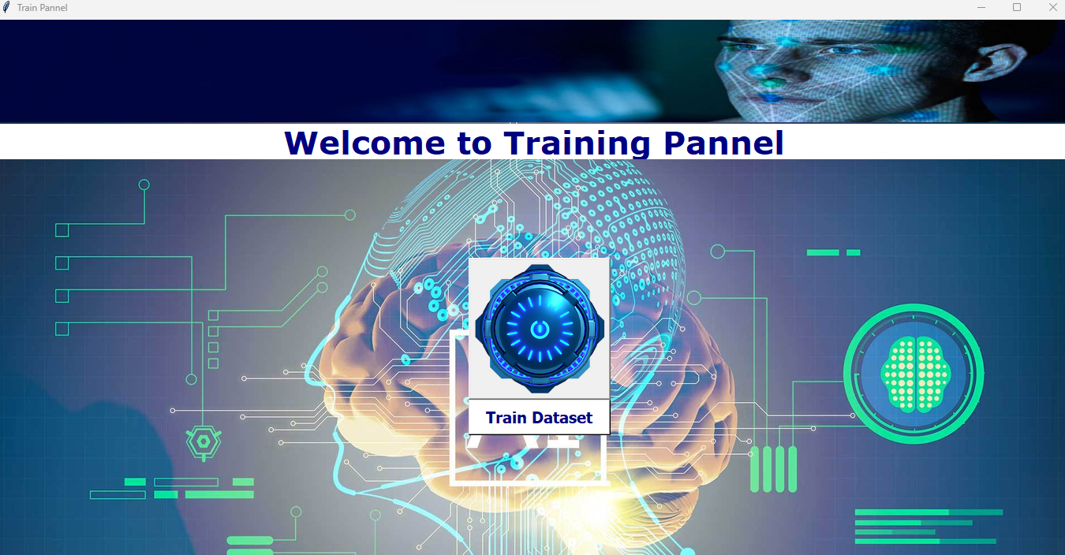
12. Result and Discussion
Train Dataset Page
Student Panel

Slide 16
13. Conclusion and Future Scope
Facial recognition attendance systems are more accurate and efficient compared to traditional attendance systems like paper registers or card-swipe systems.
Facial recognition attendance systems eliminate the possibility of proxy attendance or buddy punching, which is common in traditional attendance systems.
Facial recognition attendance systems save time and effort in recording attendance, calculating attendance data, and generating reports.
Future Scope:
Facial recognition attendance systems can be integrated with biometric authentication systems like fingerprint or iris recognition to enhance security.
Facial recognition attendance systems can be integrated with IoT devices to track attendance in remote locations or work-from-home scenarios.

Slide 17
14.References
[1] A. S. Tolba, A.H. El-Baz, and A.A. El-Harby et al. “Face Recognition and Identification using Deep Learning Approach”. International Journal of Advanced Computer Science and Applications, (vol. 54, pp. 303-308) (2019).
[2] Han Y. et al. “A Real-Time Facial Recognition System for Classroom Attendance Management”. International Journal of Innovative Computing, Information and Control, (vol. 15(3), pp. 1057-1070,)(2016)
[3] Jain, A. K. et al. “Handbook of Biometrics (2nd ed.)” by Springer (vol. 21, pp. 350-387) (2016)

Slide 18
Thank You...!!

